Slide 1
GOOGLE PLAY STORE
14 SQL questions on 9,648 apps
Pandas + SQLite. Ratings not filled with the mean.
Installs are bucket floors, not exact counts.

Slide 2
What is in the file
9,648 unique apps after dropping the Category=1.9 row and duplicate names.
8,190 have a rating (median 4.3). 1,458 have none — left missing.
8,895 free / 753 paid.
29,692 unique reviews (duplicates dropped) across 865 apps.
64% positive, 21% negative, 15% neutral.
Play Store · practice project
2 / 9

Slide 3
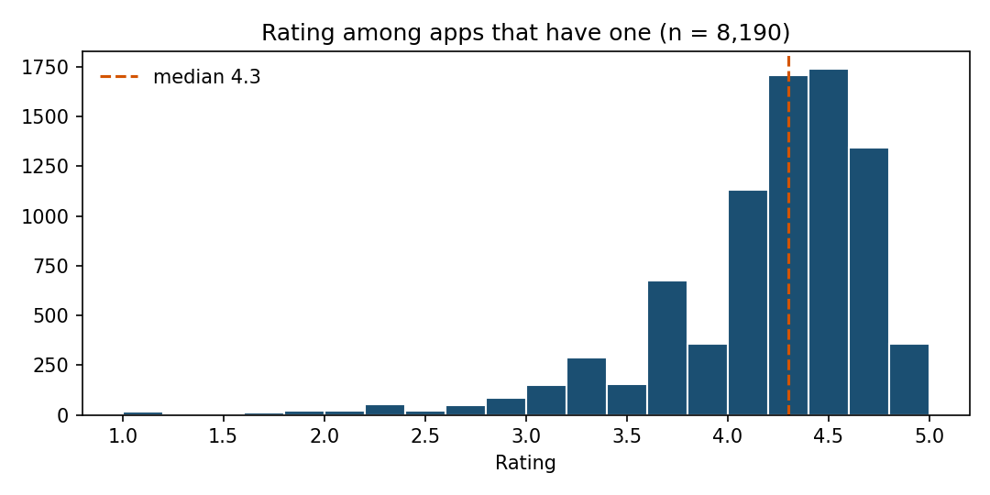
Q1–Q3 · rating vs reviews
Highest rating is 5.0 — 271 apps.
Most of those have <150 reviews.
Top 5.0 by reviews: Ríos de Fe (141).
Most reviewed app overall:
Facebook · SOCIAL
78,158,306 reviews · 1B+ installs.
A 5.0 with a hundred reviews is not a better product than Facebook at 4.x.
Play Store · practice project
3 / 9

Slide 4
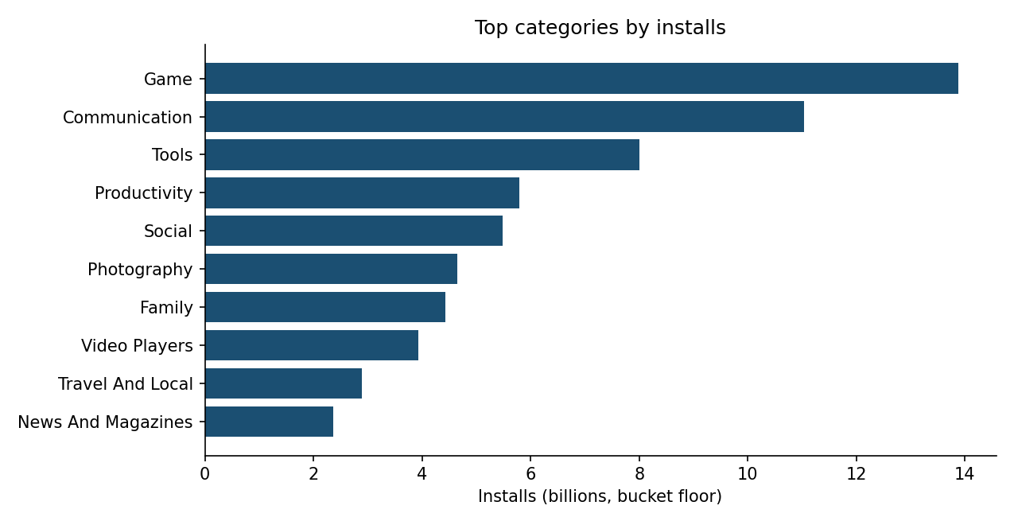
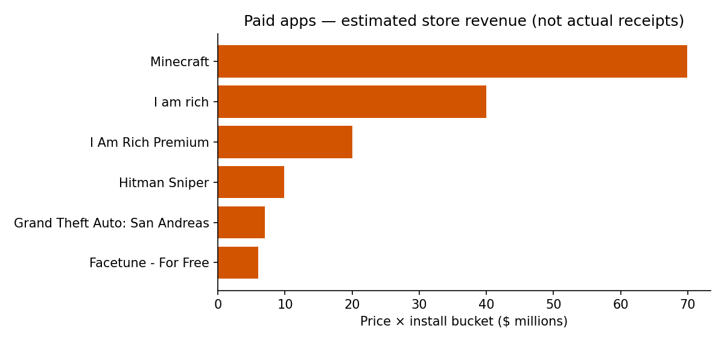
Q4–Q6 · money, installs, catalogue
GAME leads installs: 13.88 billion (bucket floor). COMMUNICATION is second.
Paid revenue estimate $291.1M. Minecraft $69.9M, then the joke “I am rich” apps.
Most published genre: Tools (824 apps).
Play Store · practice project
4 / 9

Slide 5
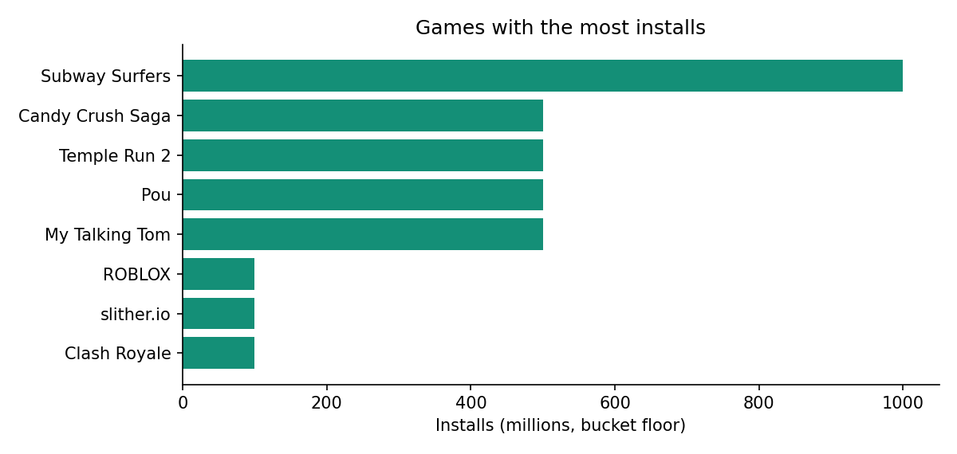
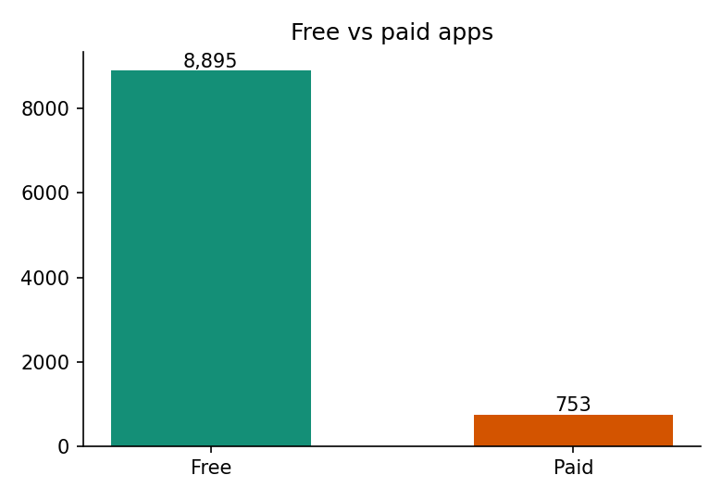
Q7–Q10 · games, Android, free/paid, dating
Subway Surfers is the only game at 1B+ installs.
1,395 apps list Android Ver = “4.0.3 and up” (exact string, not “4.0.3 or later”).
92% free. Best dating app by reviews: Zoosk (516,801 reviews, rating 4.0).
Play Store · practice project
5 / 9

Slide 6
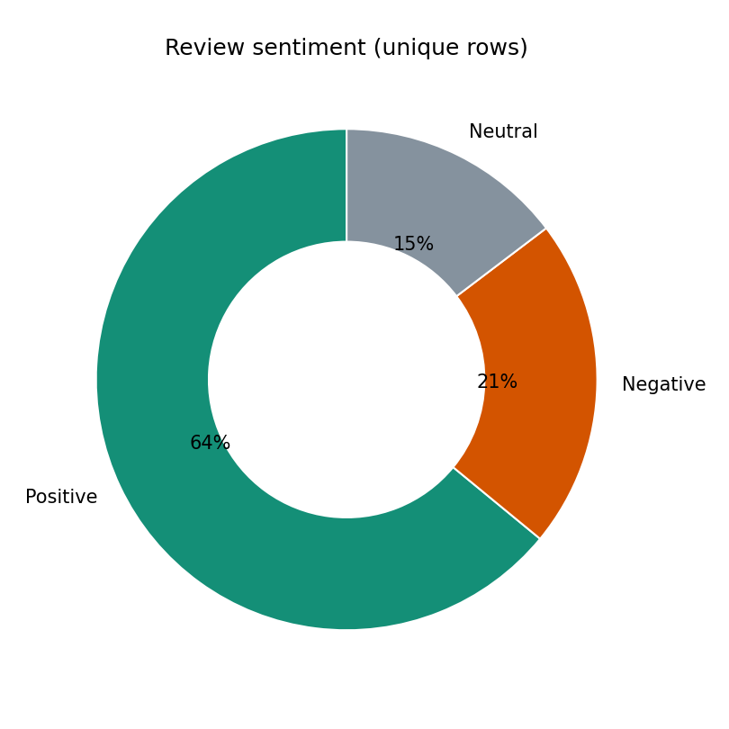
Q11–Q14 · review table
10 Best Foods for You — unique reviews:
79 positive, 11 neutral, 5 negative.
ASUS SuperNote, polarity=1 and subjectivity=1:
“Awesome!!!!” (one row)
Abs Training-Burn belly fat, Neutral: 5 comments.
Adobe Acrobat Reader, Negative: 20 unique comments.
Play Store · practice project
6 / 9

Slide 7
What I would not claim
• 5.0 is not a ranking. It is a small-sample ceiling.
• $291M is not Google’s revenue. It is list price times a rounded install bucket.
• Q8 is an exact version string. Apps on 4.1+ are a different count.
• Reviews cover 865 of 9,648 apps. Sentiment is not store-wide.
Play Store · practice project
7 / 9

Slide 8
How this was run
Stack: pandas and SQLite. No Power BI in this repo.
Cleaning: drop Category=1.9, drop duplicate app names, restore missing ratings, drop duplicate reviews.
SQL: sql/queries.sql. The notebook checks that pandas and SQLite match on the headline queries.
Play Store · practice project
8 / 9

Slide 9
Facebook has the reviews.
GAME has the installs.
5.0 is a crowded room.

